Slide 1
Targeting Immune Checkpoint Therapy Resistance with Novel MSC-Engineered Extracellular Vesicles
Yves Greatti
April 29, 2024

Slide 2
Significance

Slide 3
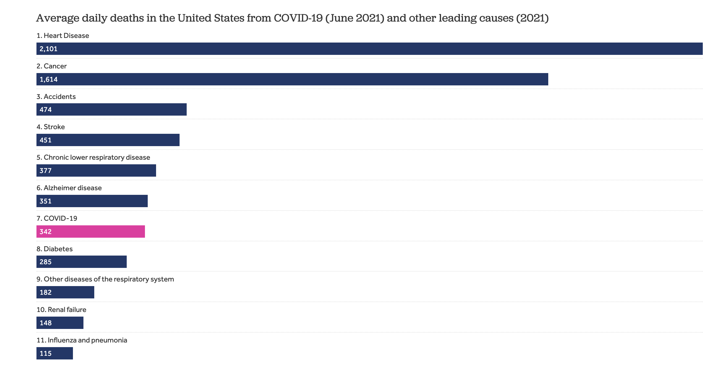
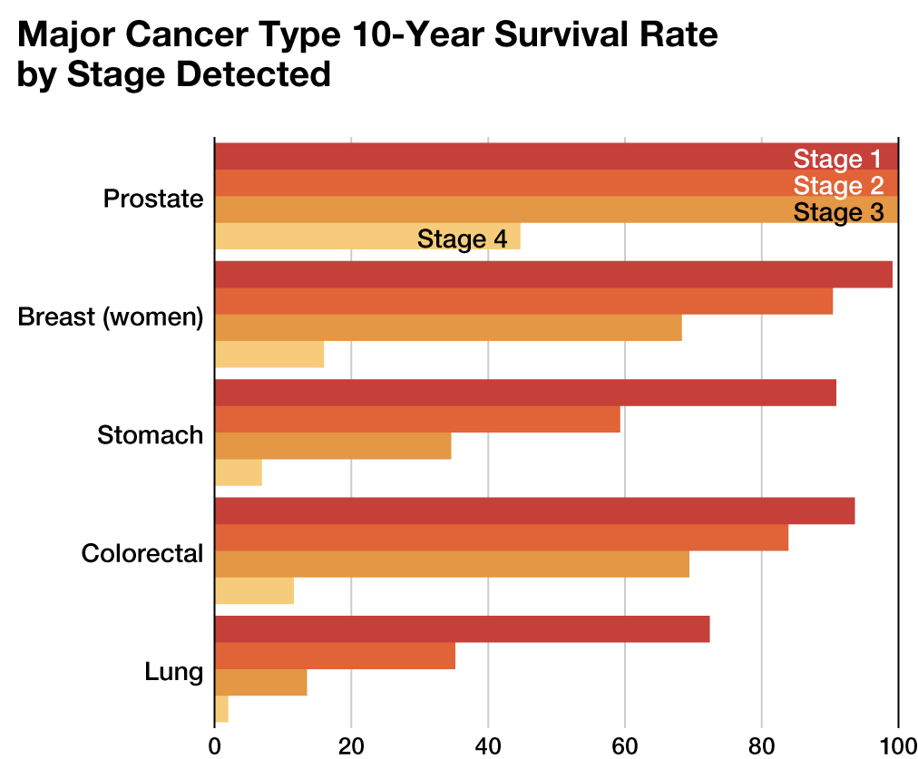
The Persistent Challenge of Cancer Today
Notes:
Economic and health impacts of cancer.

Slide 4
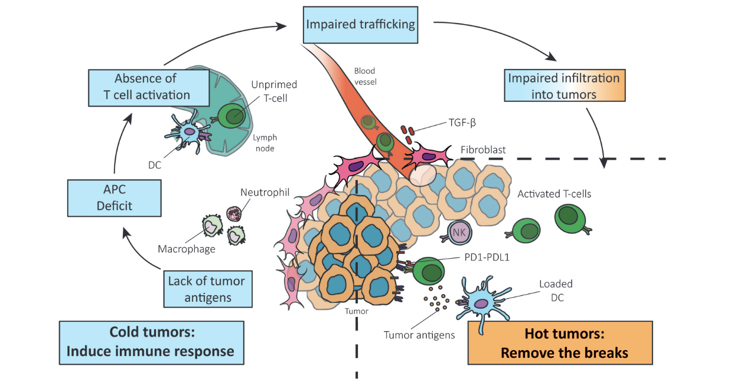
Reversing Cold Tumor Into a Hot Tumor
Notes:
Challenges posed by cold tumors in cancer treatment.
Importance of transforming cold tumors to hot tumors to enhance the efficacy of immunotherapies.

Slide 5
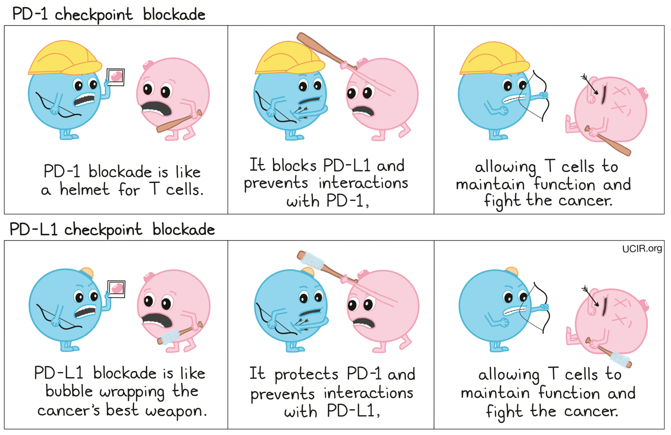
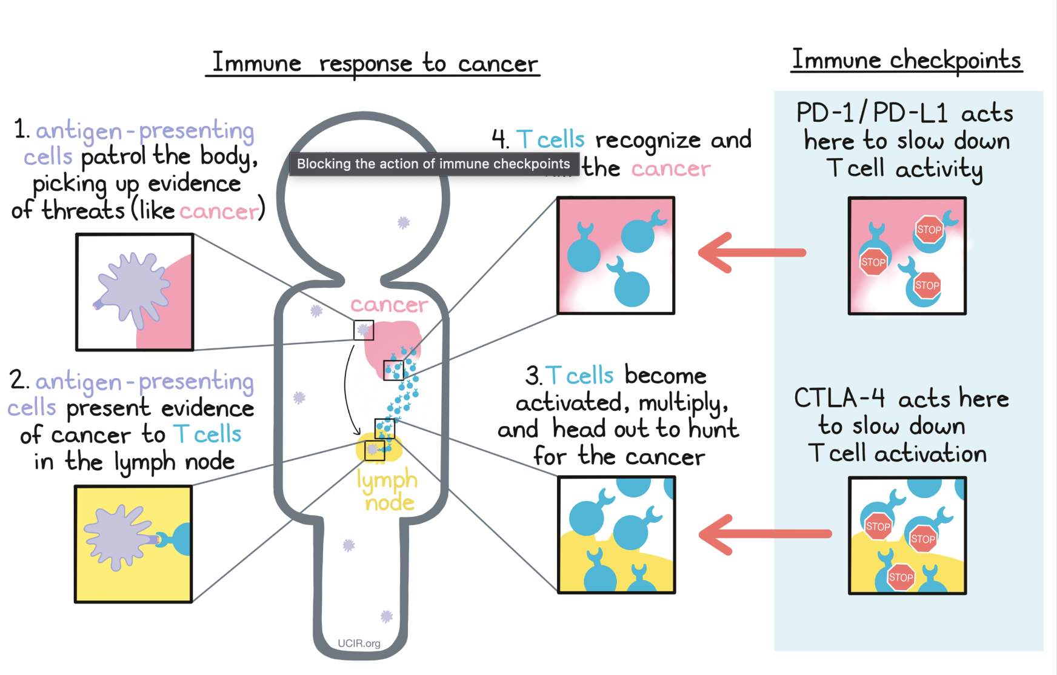
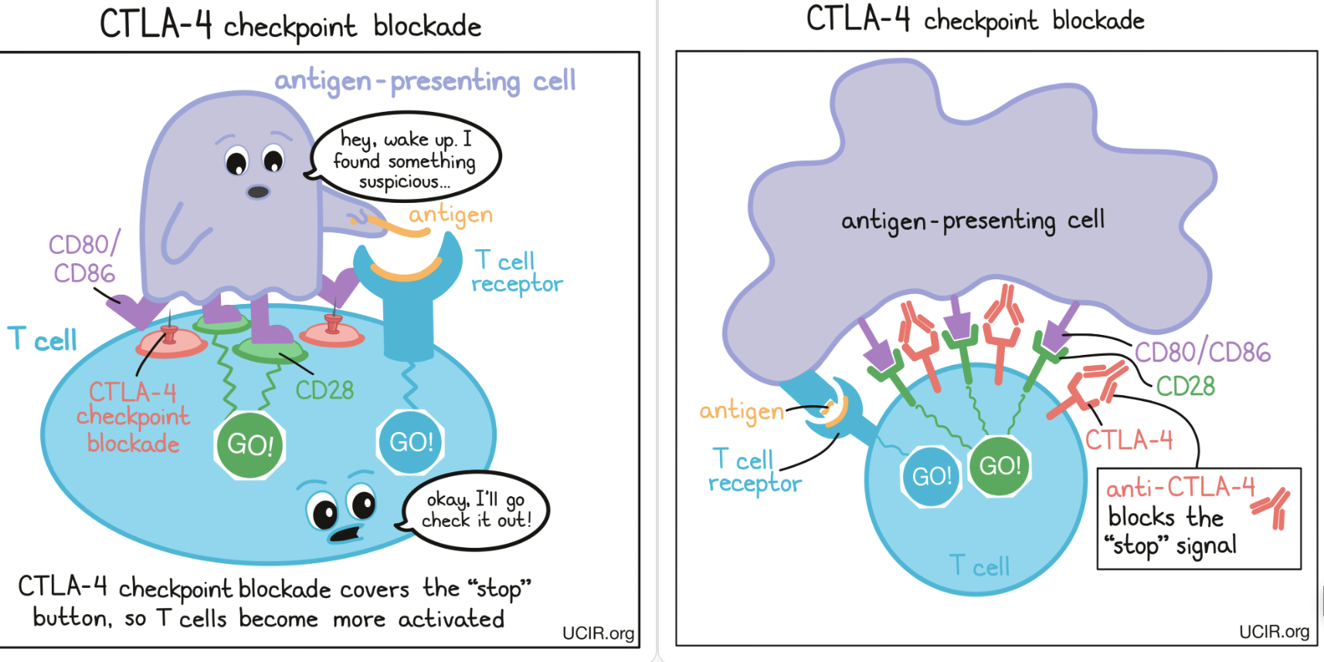
Immune Checkpoint Blockade Therapy
Notes:
Advances in immune checkpoint inhibitors (ICIs) and their limitations in cold tumors.

Slide 6
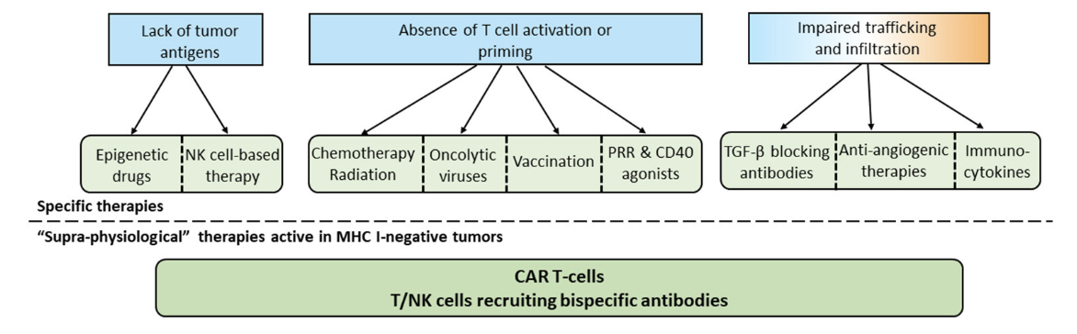
Common Approaches to Overcome Absence of T cells
Notes:
current landscape of strategies for warming up cold tumors.

Slide 7
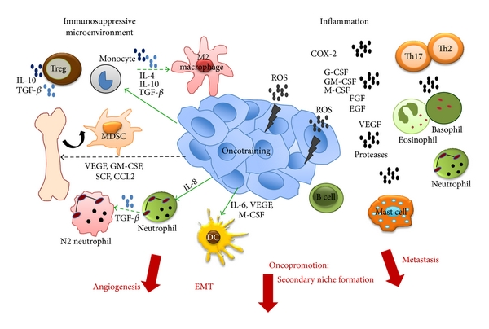
Pro-tumoral activities of the Immune System
Notes:
Dual role of immune cells in TME; show immunosupression here (positive)
includes immune cells, signaling molecules, ECM and so on. Immune cells play a critical role in the tumor microenvironment, influencing the development, progression, and metastasis of tumors through the combined action of many cytokines
The fact that immune cells can behave as guardians (anti-tumour immunity) or as bystanders or supporters of the tumour (pro-tumour immunity) makes them a “double-edged sword” in the TME.

Slide 8
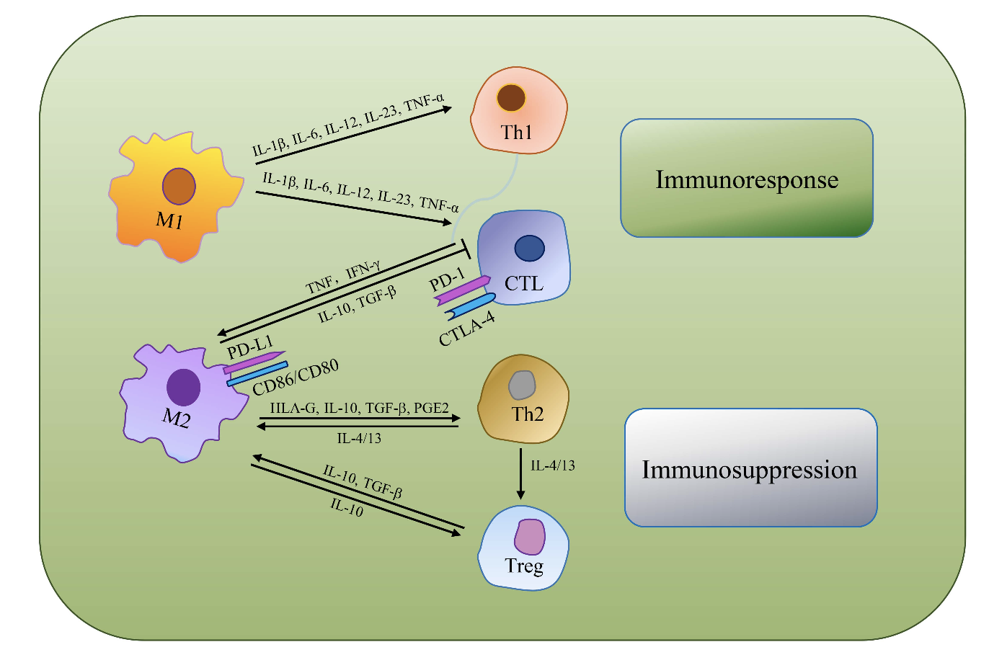
Tumor Associated Macrophages (TAMs)
TAMs as often the most dominant immune cell type, are an indispensable target for immunologically cold tumor
Notes:
Role of Tumor-associated macrophages (TAMs) and other immune cells in cold tumors.
TAMs play a significant role in cancer biology, including influencing tumor growth, angiogenesis, metastasis, and the suppression of antitumor immunity.
Their abundance and multifunctional roles make them key players in tumor ecology and an important focus in cancer research and therapeutic development.

Slide 9
Innovation

Slide 10
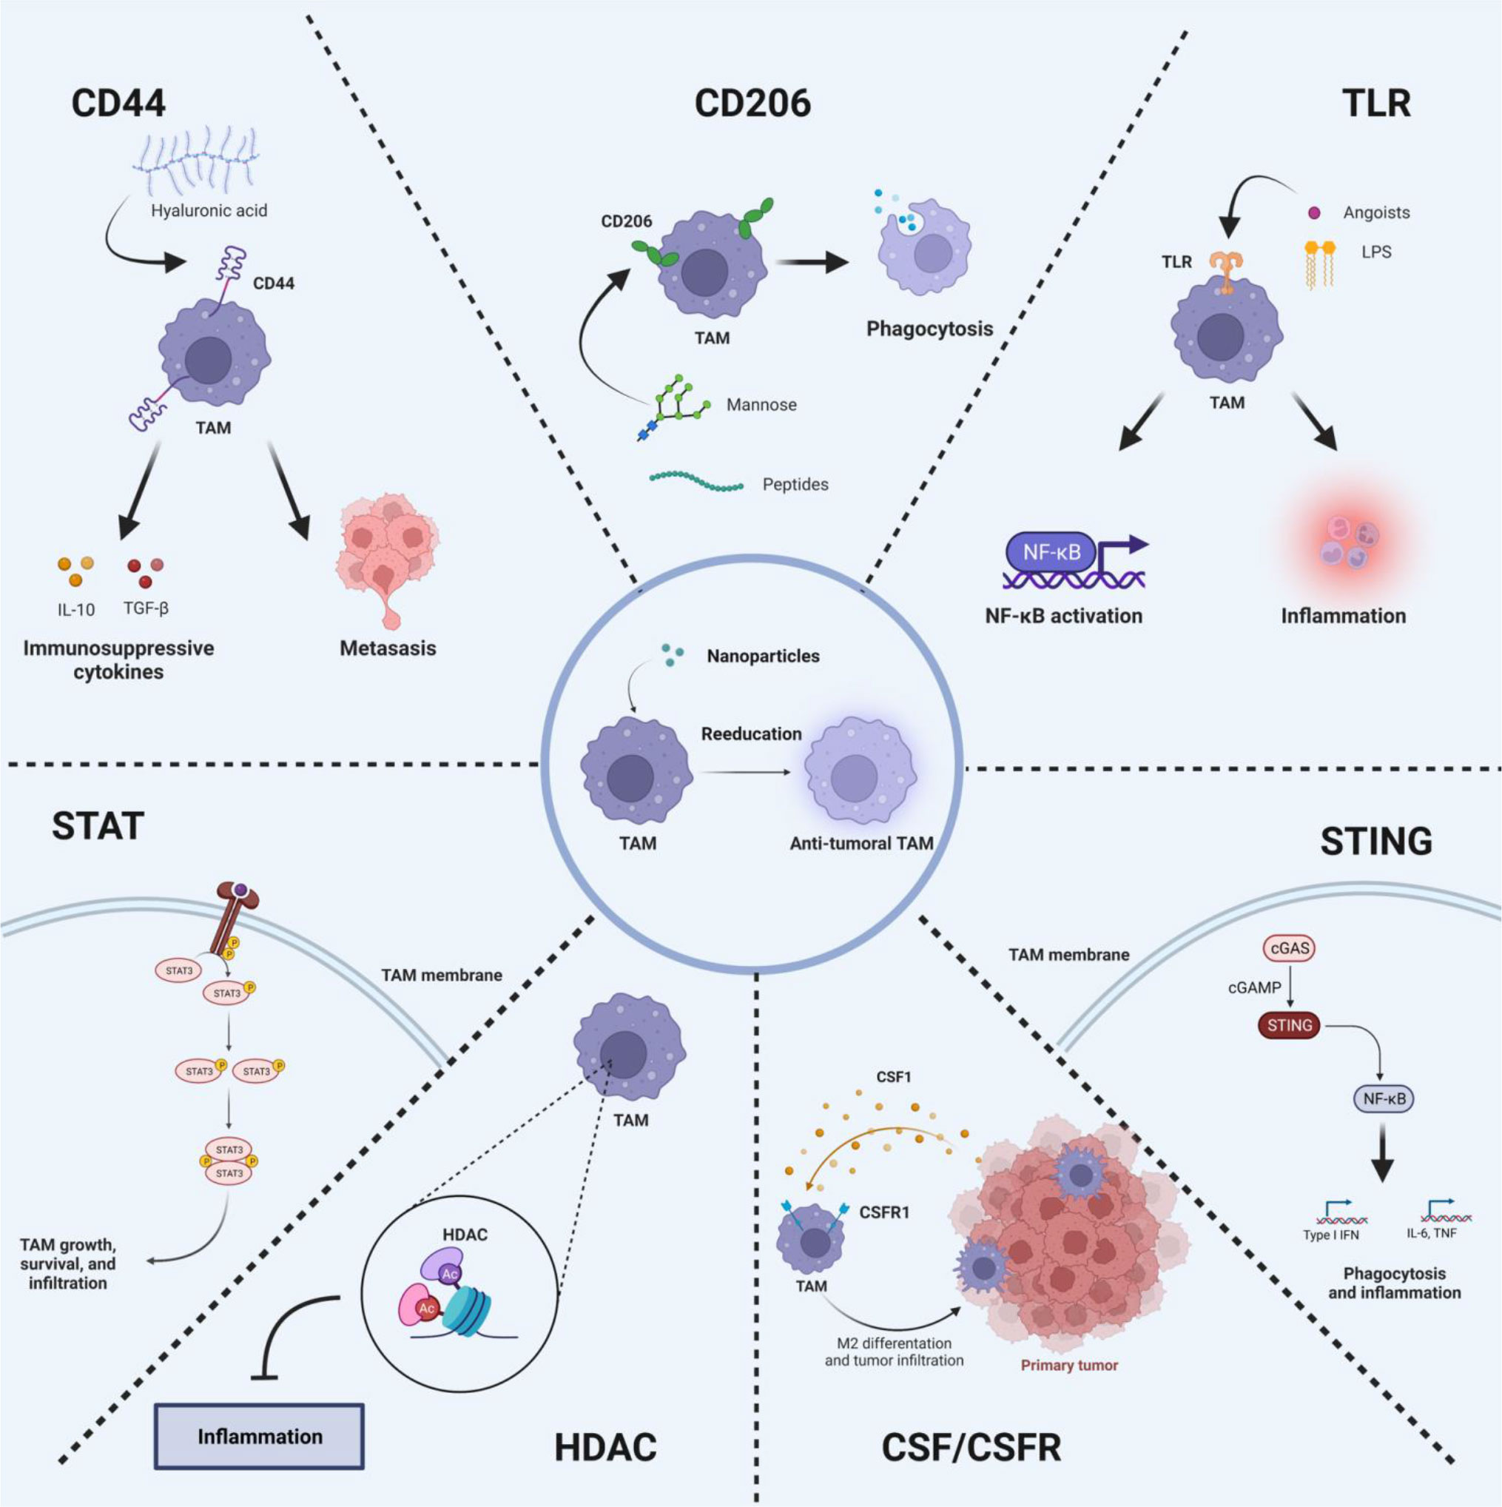
Strategies to reeducate TAMs
Notes:
TLRs are a class of pattern recognition receptors that can detect the substances derived from invading pathogens, which
play essential roles in innate immunity and inflammatory responses.
Colony Stimulating Factor-1(CSF-1), also recognized as colony-stimulating factor (M-CSF), is a cytokine considered a major growth factor regulating the production, differentiation
and function of TAM (91). CSF-1 is associated with tumor progression, metastasis, angiogenesis, and treatment resistance.
CD44 is a transmembrane adhesion glycoprotein. Aberrant upregulation of CD44 in tumor cells is closely related to tumor immune escape and invasion.
CD206 is a membrane-bound protein c
The JAK-STAT pathway is an inflammatory signaling pathway. STAT signaling is important for macrophage polarization,
while IFN-g signaling inducing phosphorylation of downstream STAT1, which in turn activate STAT1.

Slide 11
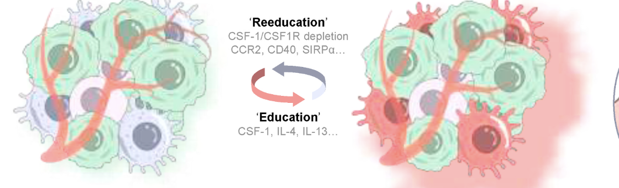
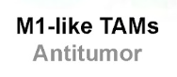
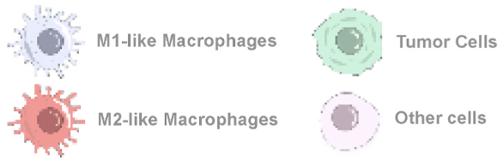
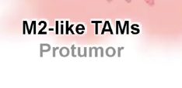
Strategic use of CSF-1/CSF1R Inhibitors to modify TAMs behavior within the TME
Notes:
Strategic use of CSF-1R inhibitors to modify the behavior of TAMs within the tumor microenvironment.
M1-like macrophages characterized by biomarkers of CCR7, CD40, CD11c, and M2-like
macrophages by markers of CD169, CD206.
M1-like and M2-like TAMs are interconversionable under stimulation of various cytokines and chemokines termed
‘education’ factors and ‘reeducation’ factors.
M2-like TAMs secrete tumorigenic cytokines, like CCL2, IL-6, IL-10, to promote tumor cell growth.
TAMs express a variety of transmembrane proteins in
response to ‘education’ factors, including CSF1R, CCR2, CD40, SIRP1α.

Slide 12
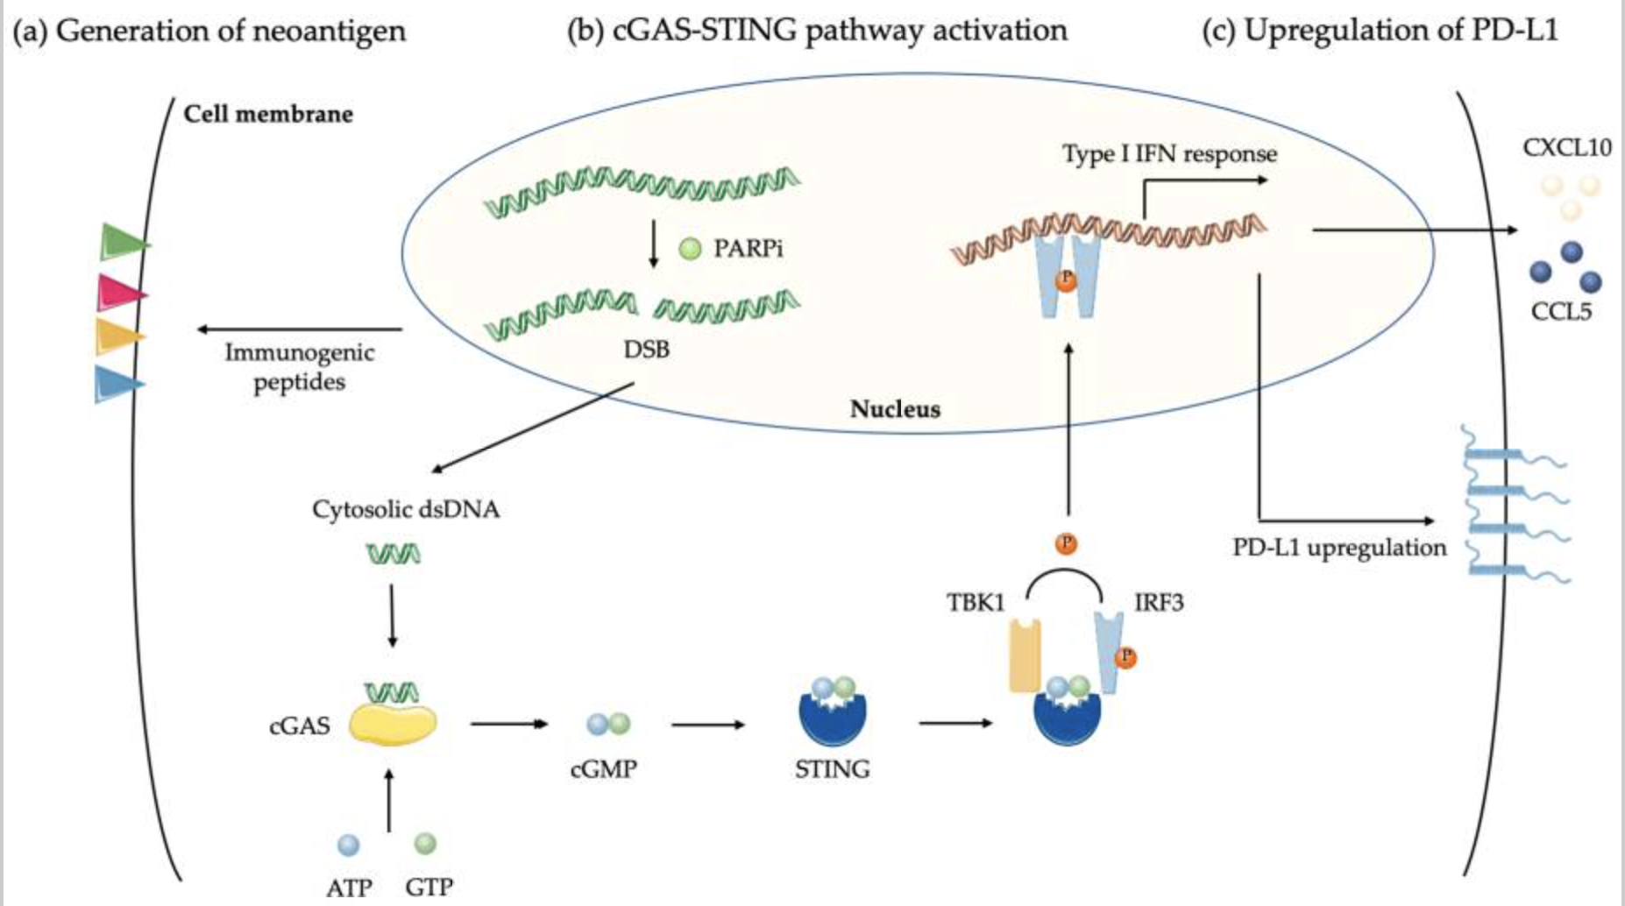
Biological effects of PARP Inhibitor on Cancer Cells
Notes:
PARPi delays DNA repair that generates double-strand breaks (DSB) and catastrophic unrepaired DNA damages in tumor cells, increasing neoantigens load and tumor mutation burden;
DSB induced by PARPi in tumor cells produce double-strand DNA (dsDNA) fragments that, through cyclic GMP-AMP synthase (cGAS) binding
lead to stimulator or interferon genes (STING) activation and the generation of a type interferon (IFN) response. This upregulates chemokines CCL5 and CXCL10 leading to T cell recruitment
(c) Upregulation of PD-L1 via STING pathway led to T cell exhaustion.

Slide 13
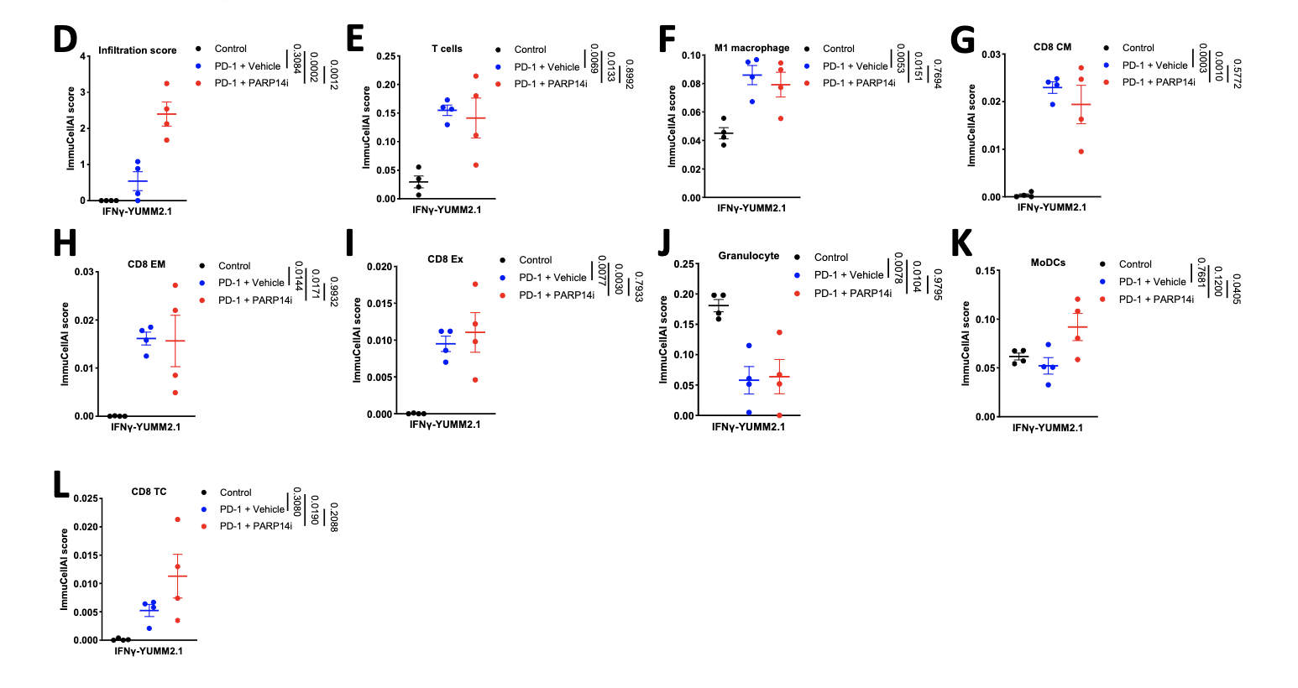
PARP14i Reverses Acquired Resistance to PD-1 Therapy
Effector T cell infiltration is
enhanced in tumors derived from cells pre-treated with IFNγ in immuno-
competent female mice when PARP14 is pharmacologically inhibited or
knocked down, while the presence of regulatory T cells is decreased, leading to
restoration of α-PD-1 sensitivity
C. W. Wong et al., “PARP14 inhibition restores PD-1 immune checkpoint inhibitor response following IFNγ-driven acquired resistance in preclinical cancer models,” Nat. Commun., vol. 14, no. 1, p. 5983, 2023, doi: 10.1038/s41467-023-41737-1
Notes:
D: infiltration, E: T cell, F: M1 macrophage,
G: CD8 central memory (CM) T cells, H: CD8 effector memory (EM) T cells,
I: exhausted (Ex) CD8 T cells, J: Granulocytes, K: Myeloid Dendritic cell (MoDC),
L: CD8 cytotoxic T cell (Tc).

Slide 14
Research Strategy

Slide 15
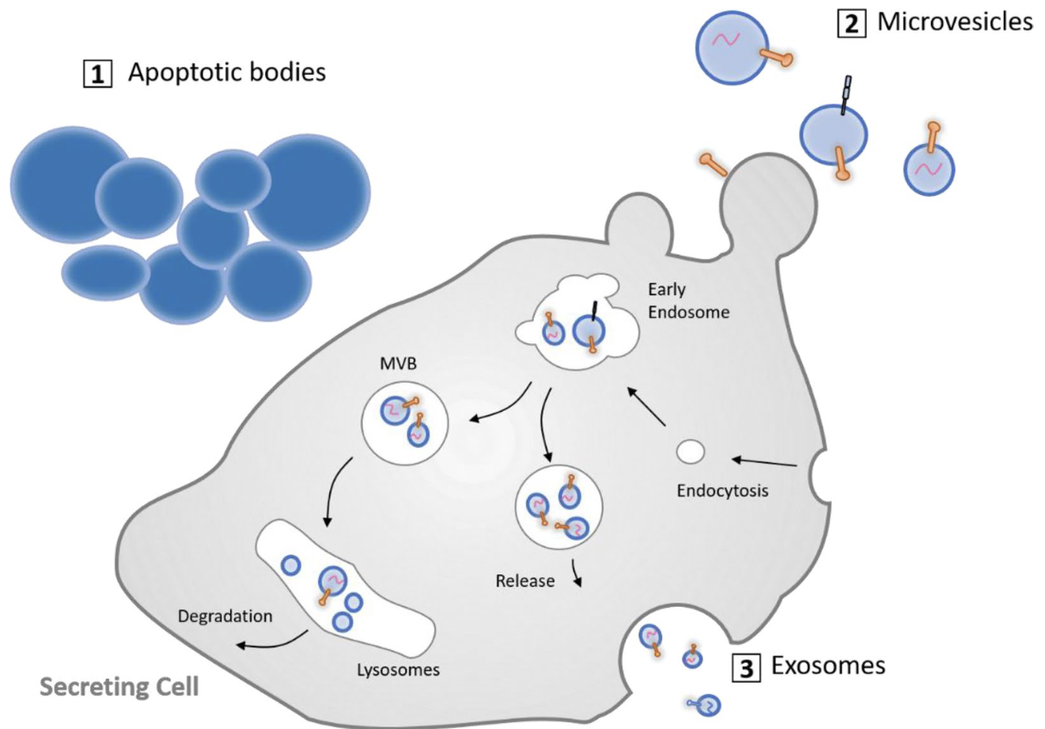
Therapeutic Potential of Mesenchymal Stem-Derived extracellular vesicles (MSC-Evs)
MSCs are favored as sources of Evs due to:
Ability to modulate the immune response
Promote tissue repair and regeneration
Low immunogenicity
Engineering flexibility
Scalable production
Notes:
Exosomes
Size: Typically 30-100 nm in diameter.
Features: Exosomes are rich in nucleic acids, proteins, and lipids. They naturally encapsulate these molecules, making them excellent carriers for small molecule drugs, RNA, or other therapeutic agents.
Usage: Due to their small size and composition, exosomes can cross biological barriers such as the blood-brain barrier, making them ideal for targeting drugs to specific sites, including the brain.
Microvesicles
Size: Typically larger than exosomes, ranging from 100 to 1000 nm in diameter.
Features: Microvesicles carry a variety of biomolecules, including proteins and lipids, and also encapsulate nucleic acids and cytosolic components.

Slide 16
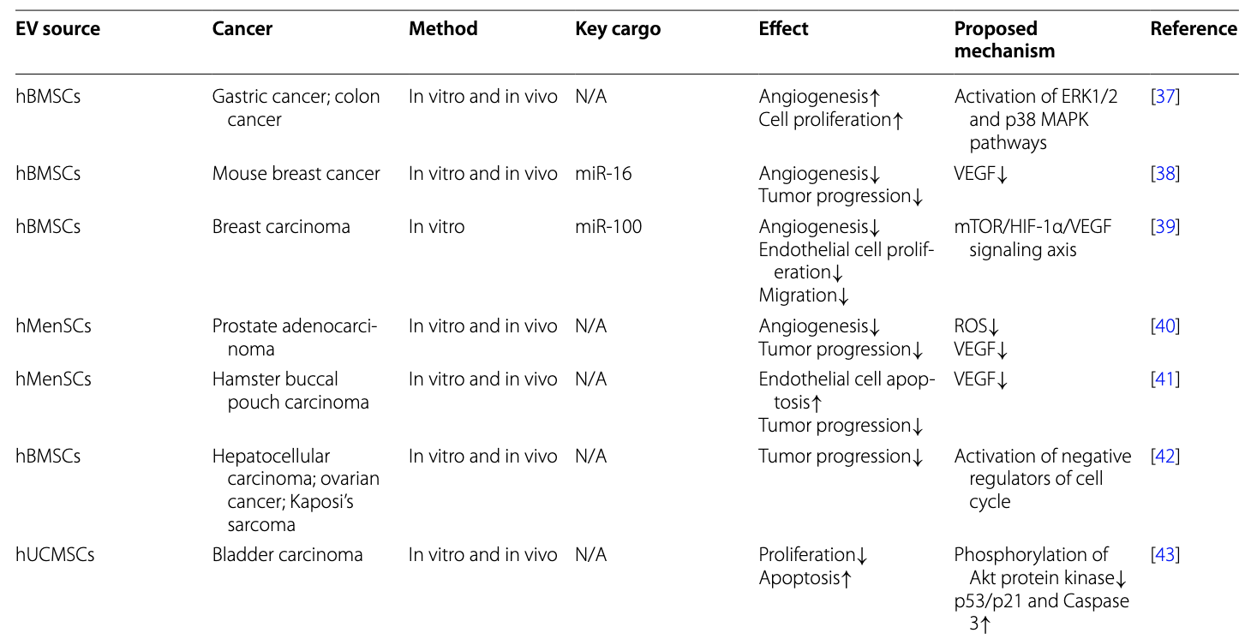
MSC-derived EVs Sources: iMSC EVs Superior anti-Inflammatory Bioactivity
Advantages
Scalability
Donor Availability
Could induce M2-like transition
D. Levy et al., “Induced pluripotent stem cell-derived extracellular vesicles promote wound repair in a diabetic mouse model via an anti-inflammatory immunomodulatory mechanism,” bioRxiv, p. 2023.03.19.533334, 2023, doi: 10.1101/2023.03.19.533334

